Slide 1
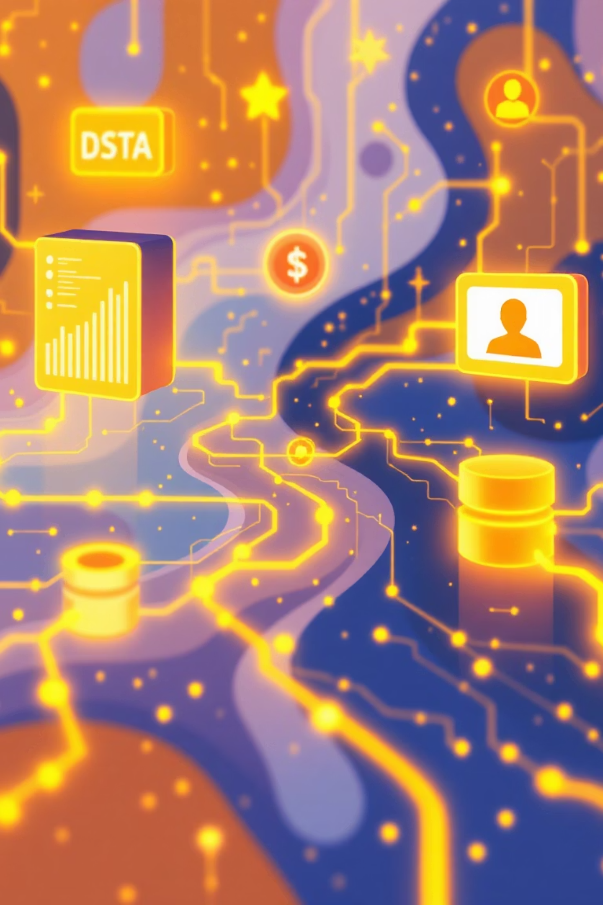
Customer Shopping Behavior Analysis
Uncovering insights from transactional data to guide strategic business decisions.

Slide 2
Project Overview & Data
Project Goal
Dataset Summary
Analyze 3,900 purchases to understand spending patterns, preferences, and subscription behavior.
Rows: 3,900
Columns: 18
Key Features: Demographics, Purchase Details, Shopping Behavior
Missing Data: 37 values in Review Rating
OPTIMIZATION
STRATEGY

Slide 3

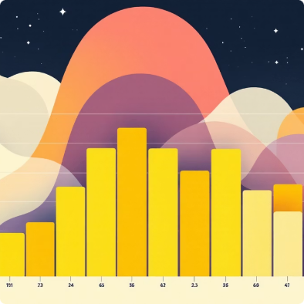
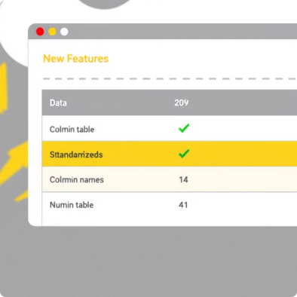
Exploratory Data Analysis (Python)
Data Loading & Exploration
Data Cleaning
Feature Engineering
Handled missing 'Review Rating' values using median imputation.
Imported dataset, checked structure and summary statistics.
Created 'age_group' and 'purchase_frequency_days' columns.

Slide 4
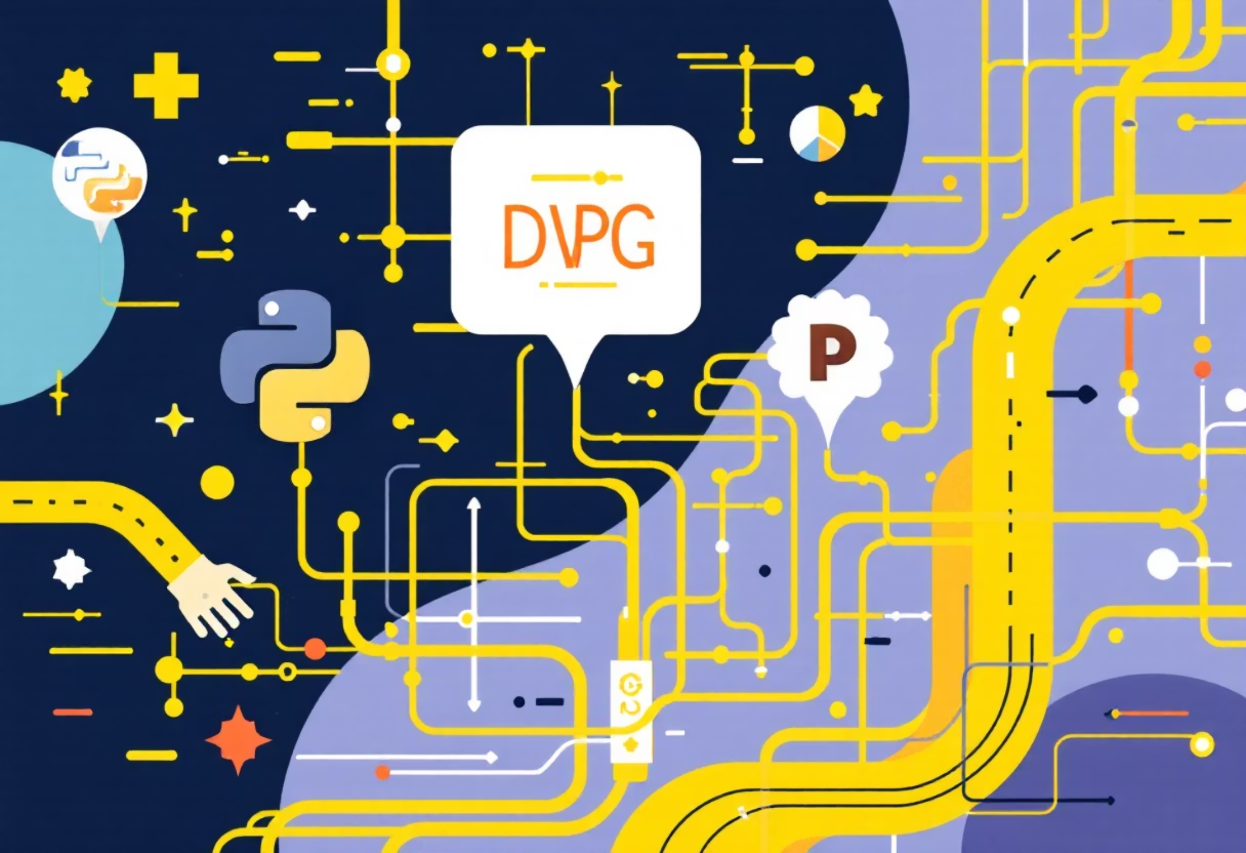
Database Integration & SQL Analysis
Seamless Workflow
Connected Python to PostgreSQL, loaded cleaned data for SQL analysis.
Key Business Questions
Structured analysis to answer critical business questions on revenue, discounts, and customer segments.

Slide 5
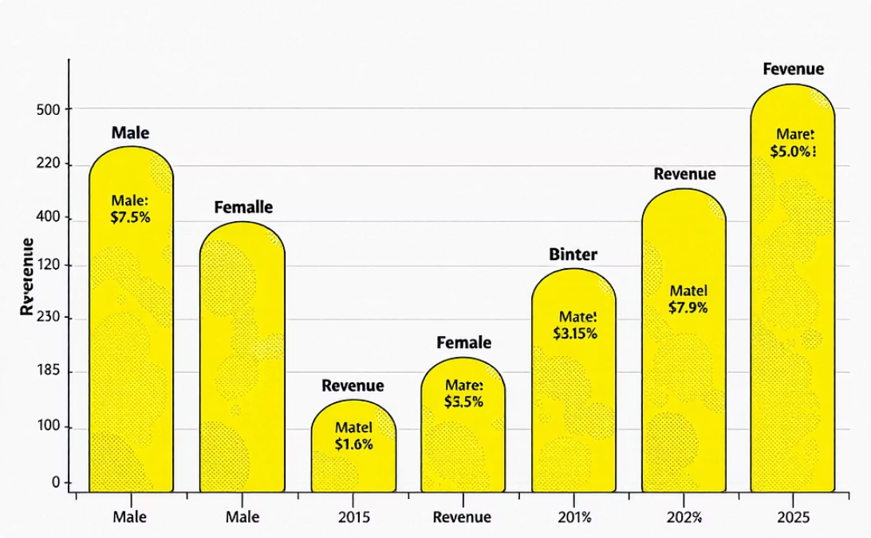
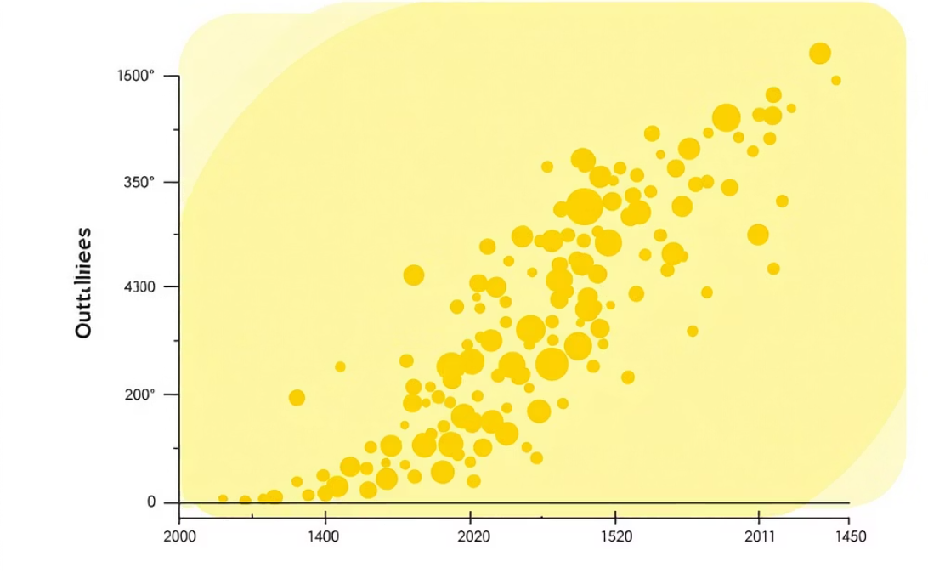
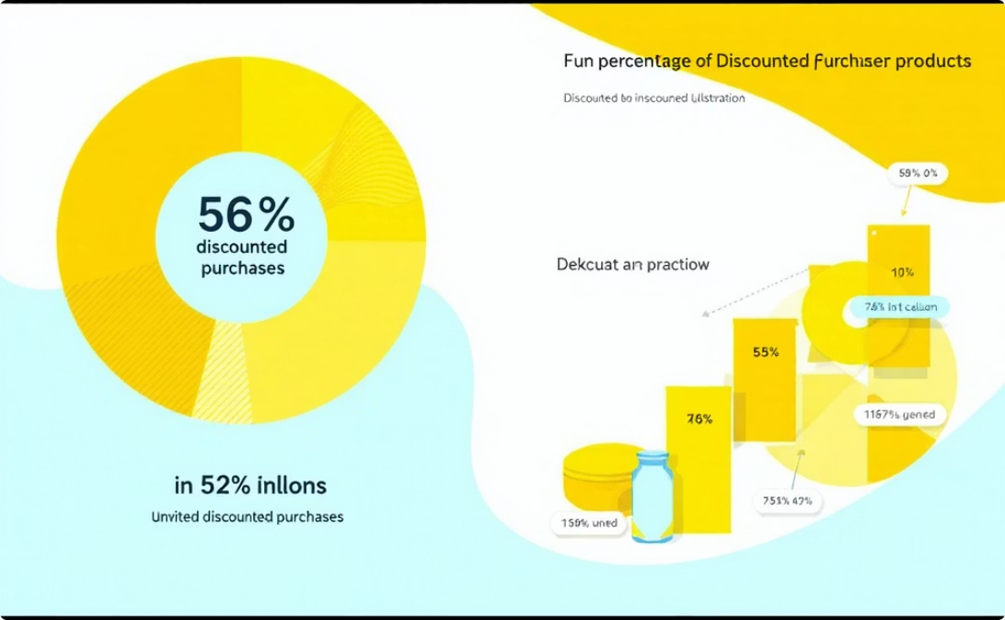
Revenue & Discount Insights
Revenue by Gender
High-Spending Discount Users
Discount-Dependent Products
Compared total revenue from male vs. female customers.
Identified customers using discounts but spending above average.
Top 5 products with highest percentage of discounted purchases.

Slide 6
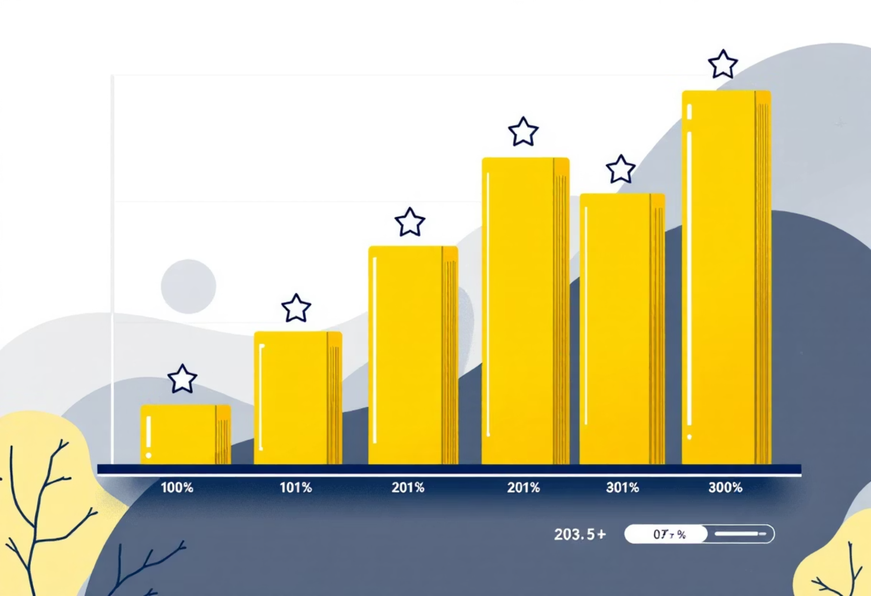
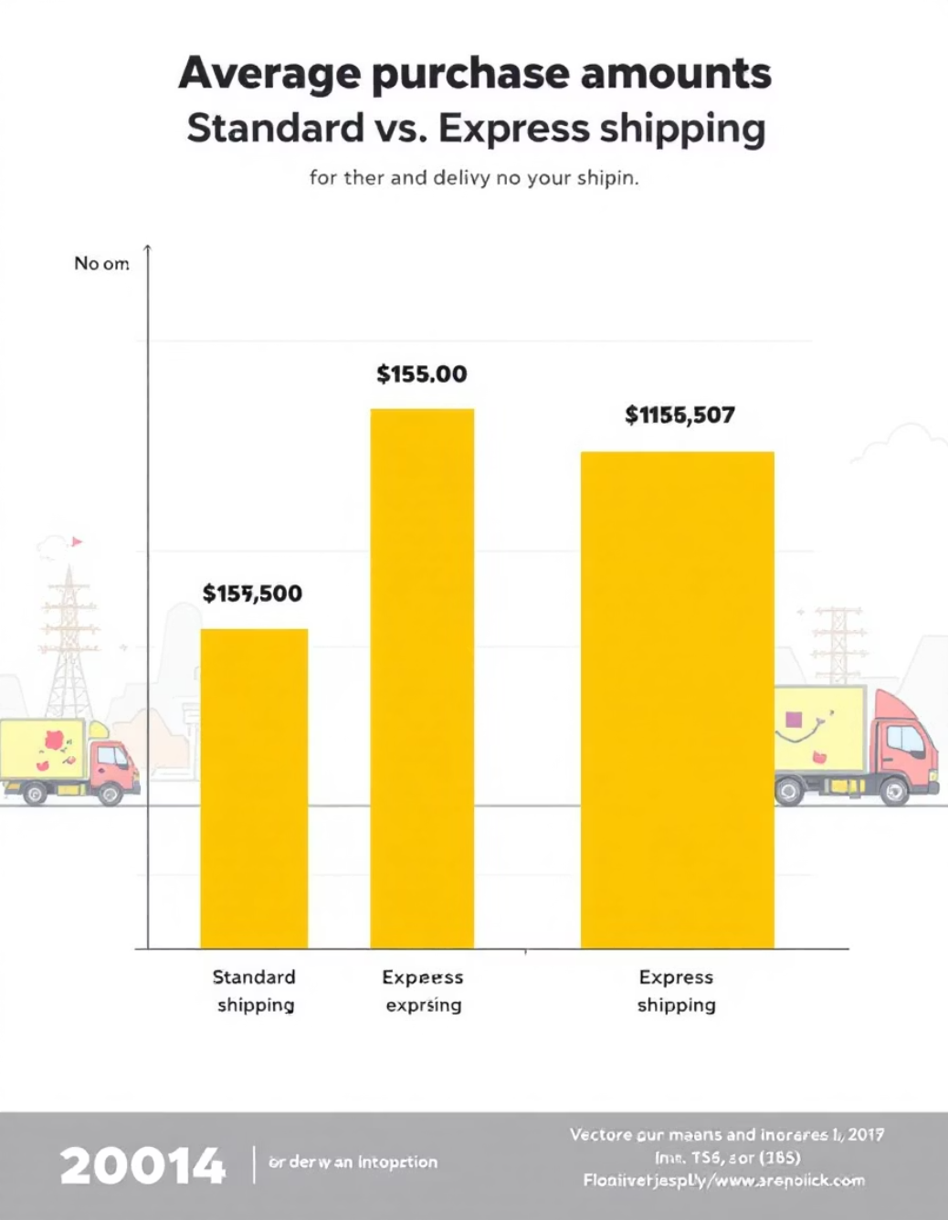
Product & Shipping Preferences
Shipping Type Comparison
Top 5 Products by Rating
Average purchase amounts between Standard and Express shipping.
Found products with the highest average review ratings.

Slide 7
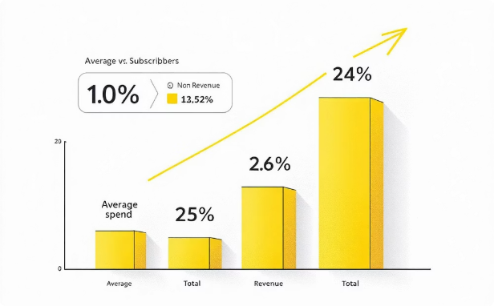
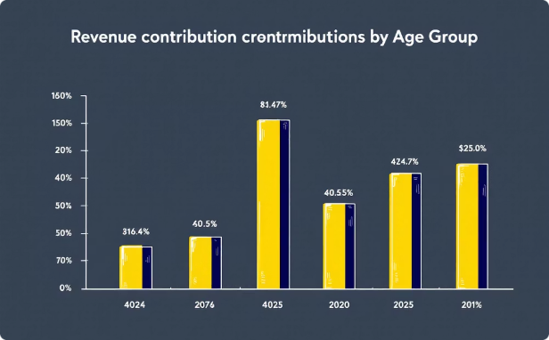
Subscription & Age Group Analysis
Subscribers vs. Non-Subscribers
Revenue by Age Group
Calculated total revenue contribution of each age group.
Compared average spend and total revenue across subscription status.

Slide 8
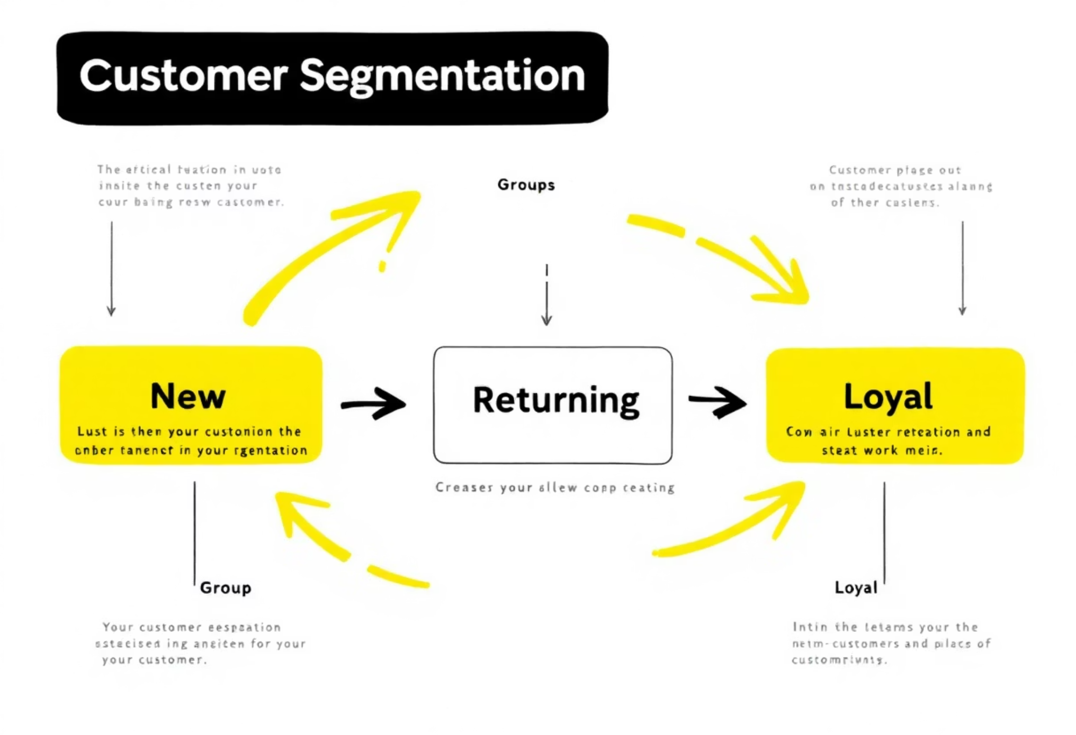
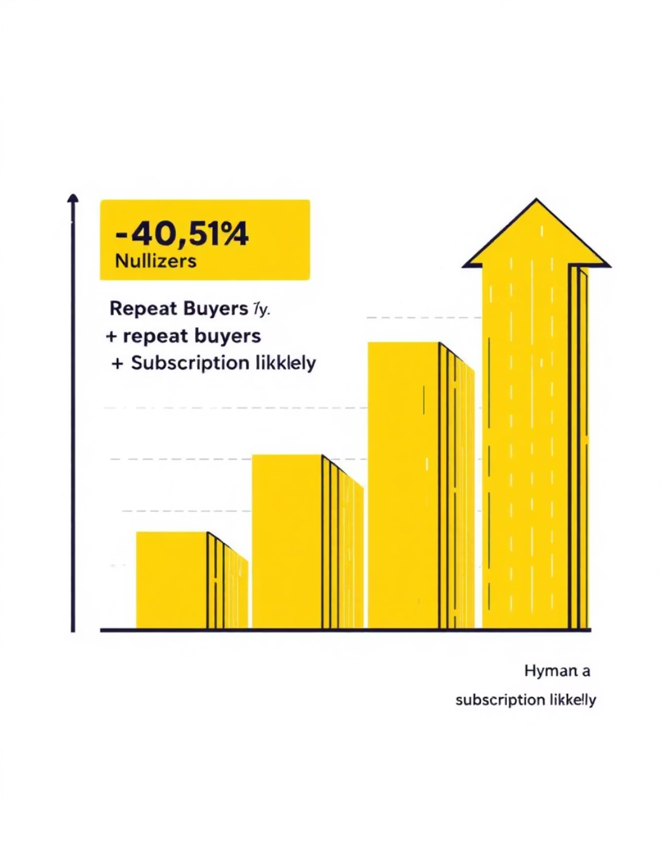
Customer Segmentation & Loyalty
Repeat Buyers & Subscriptions
Customer Segmentation
Checked if customers with >5 purchases are more likely to subscribe.
Classified customers into New, Returning, and Loyal segments based on purchase history.

Slide 9
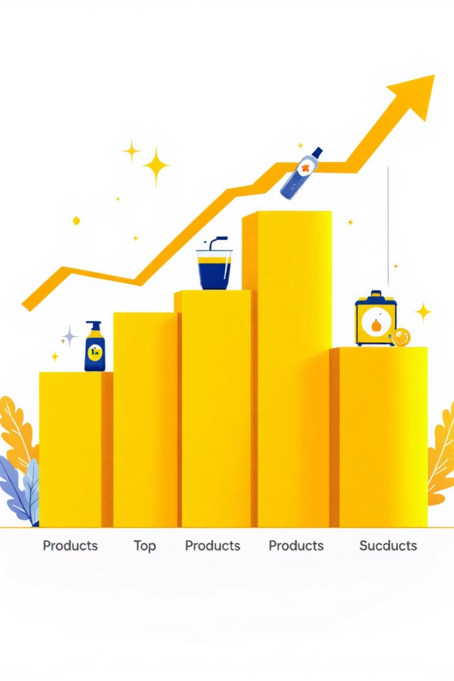
Top Products by Category
Listed the most purchased products within each category, revealing diverse preferences.

Slide 10

Business Recommendations
Boost Subscriptions
Customer Loyalty
Promote exclusive benefits for subscribers.
Reward repeat buyers to foster loyalty.
Review Discount Policy
Targeted Marketing
Balance sales boosts with margin control.
Focus efforts on high-revenue age groups and express-shipping users.

